Slide 1
MongoDB

Slide 2
Introduction
About NoSQL and MongoDB
Overview of MongoDB
Comparison of RDMBS and MongoDB
Advantages of MongoDB over RDBMS
Why Use MongoDB?
Where to Use MongoDB?

Slide 3
About NoSQL and MongoDB
NoSQL
A NoSQL originally referring to non SQL or non relational is a database that provides a mechanism for storage and retrieval of data.
This data is modelled in means other than the tabular relations used in relational databases.
NoSQL databases are used in real-time web applications and big data and their use are increasing over time.
NoSQL systems are also sometimes called Not only SQL to emphasize the fact that they may support SQL-like query languages.

Slide 4
About NoSQL and MongoDB
Types of NoSQL database:
Types of NoSQL databases and the name of the databases system that falls in that category are:
Key value store: Memcached, Redis, Coherence
Tabular: Hbase, Big Table, Accumulo
Document based: MongoDB, CouchDB, Cloudant

Slide 5
Overview of MongoDB
Database - Database is a physical container for collections. Each database gets its own set of files on the file system. A single MongoDB server typically has multiple databases.
Collection - Collection is a group of MongoDB documents. It is the equivalent of an RDBMS table. A collection exists within a single database. Collections do not enforce a schema. Documents within a collection can have different fields. Typically, all documents in a collection are of similar or related purpose.

Slide 6
Overview of MongoDB
Document - A document is a set of key-value pairs. Documents have dynamic schema. Dynamic schema means that documents in the same collection do not need to have the same set of fields or structure, and common fields in a collection's documents may hold different types of data.

Slide 7
Comparison RDBMS and MongoDB
The following table shows the relationship of RDBMS terminology with MongoDB.
RDBMS | MongoDB
Database | Database
Table | Collection
Tuple/Row | Document
column | Field
Table Join | Embedded Documents
Primary Key | Primary Key (Default key _id provided by mongodb itself)
Database Server and Client
Mysqld/Oracle | mongod
mysql/sqlplus | mongo

Slide 8
Advantages of MongoDB over RDBMS
Schema less − MongoDB is a document database in which one collection holds different documents. Number of fields, content and size of the document can differ from one document to another.
Structure of a single object is clear.
No complex joins.

Slide 9
Advantages of MongoDB over RDBMS
Deep query-ability. MongoDB supports dynamic queries on documents using a document-based query language that's nearly as powerful as SQL.
Ease of scale-out − MongoDB is easy to scale.
Conversion/mapping of application objects to database objects not needed.
Uses internal memory for storing the (windowed) working set, enabling faster access of data.

Slide 10
Why Use MongoDB?
Document Oriented Storage − Data is stored in the form of JSON style documents.
Index on any attribute
Replication and high availability
Auto-sharding
Rich queries
Fast in-place updates
Professional support by MongoDB

Slide 11
Where to Use MongoDB?
Big Data
Content Management and Delivery
Mobile and Social Infrastructure
User Data Management
Data Hub

Slide 12
Environment for MongoDB
Installation of MongoDB On Windows
Starting MongoDB and Stopping MongoDB
Restarting MongoDB
Getting Help in MongoDB
Obtaining MongoDB Statistics

Slide 13
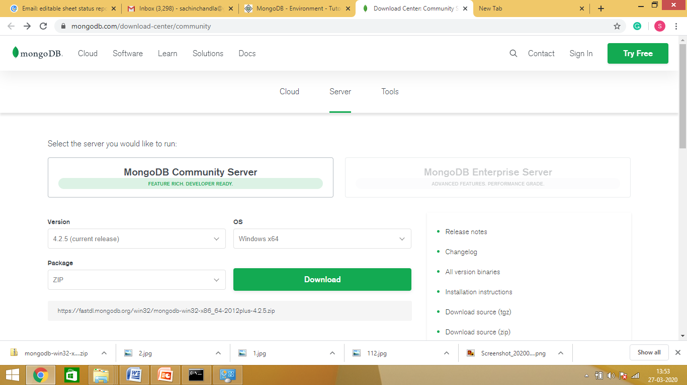
Installation of MongoDB on Windows
First download the latest release of MongoDB from https://www.mongodb.org/downloads

Slide 14
Installation of MongoDB on Windows
Download in ZIP format in C Drive
Unzip / Extract the downloaded file “mongodb-win32-x86_64-2012plus-4.2.5”
Make a new directory with name “mongodb” in C Drive.
Move “Bin” folder and files from “mongodb-win32-x86_64-2012plus-4.2.5” to “mongodb”.

Slide 15
Installation of MongoDB on Windows
MongoDB requires a data folder to store its files.
Create a folder in C drive with name “data” and a sub folder with name “db”.
The default location for the MongoDB data directory is c:\data\db.

Slide 16
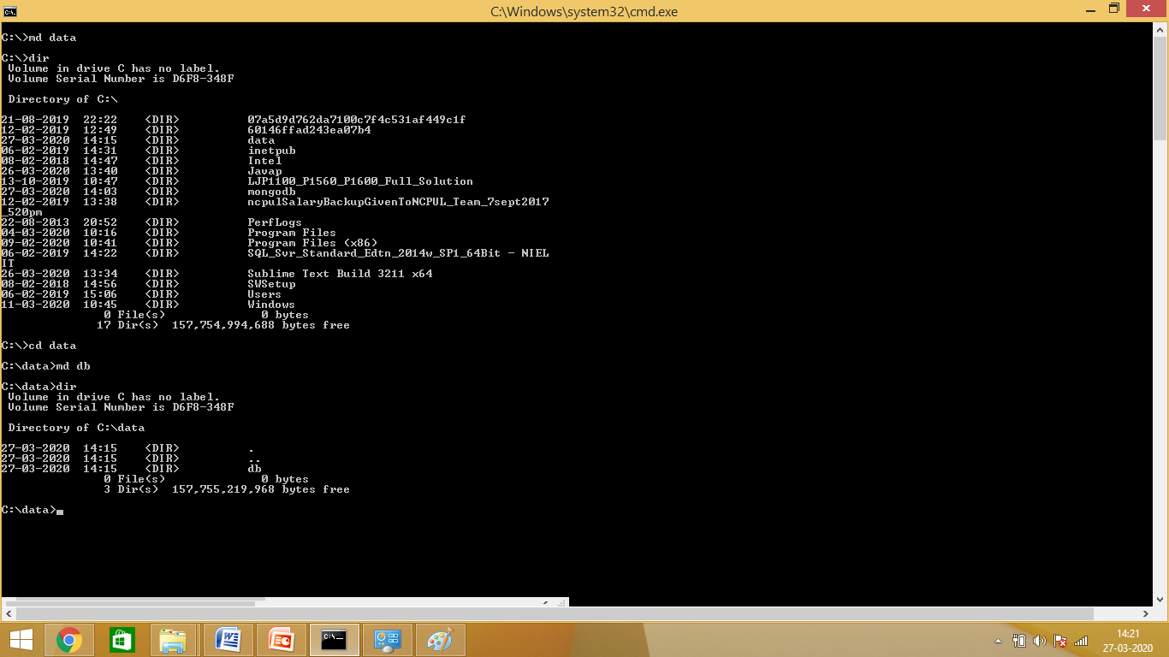
Installation of MongoDB on Windows
Using Command Prompt

Slide 17
Running MongoDB Windows Service
Setting up dbpath in mongod.exe.
In command Prompt
C:\> cd mongodb
C:\mogodb>cd bin
C:\mongodb\bin\mongod.exe - -dpath “c:\data”

Slide 18
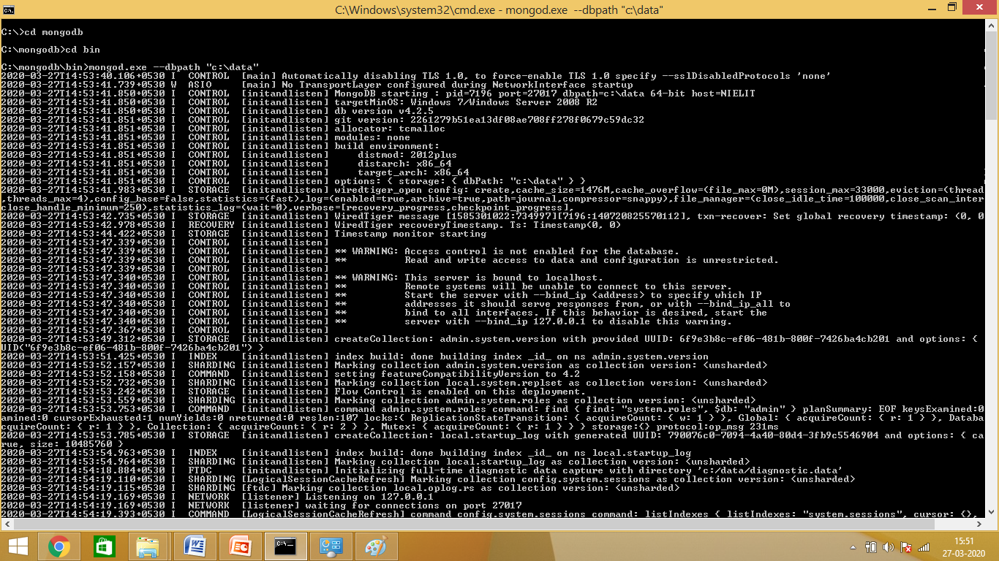
Installation of MongoDB on Windows
Running Status

Slide 19
Running MongoDB Windows Service
Setting of path is to be done for first time only. Next time onwards server is to be started with the following commands.
Go to command prompt than reach upto to bin directory .
For running MongoDB Windows Service
“ C:mongodb\bin\mongod.exe “

Slide 20
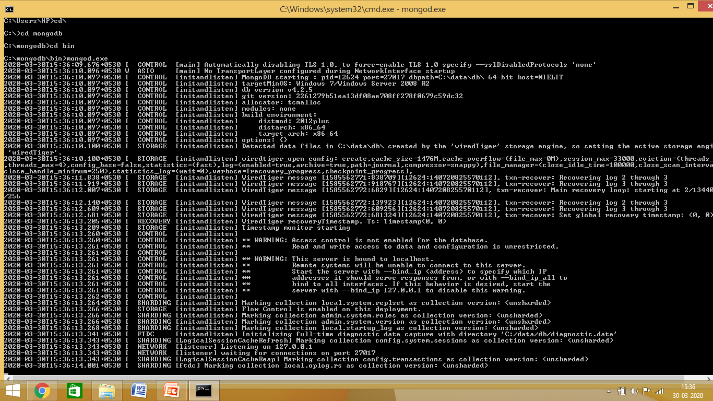
Running MongoDB Windows Service
Running Status
Waiting for Connection Message

Slide 21
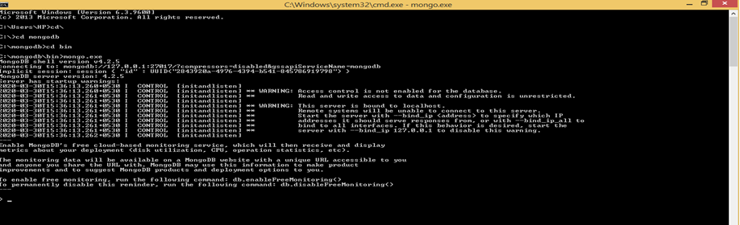
Running Mongo Shell
Open another Command Prompt
Run command
C:\mongodb\bin\mongo.exe

Slide 22
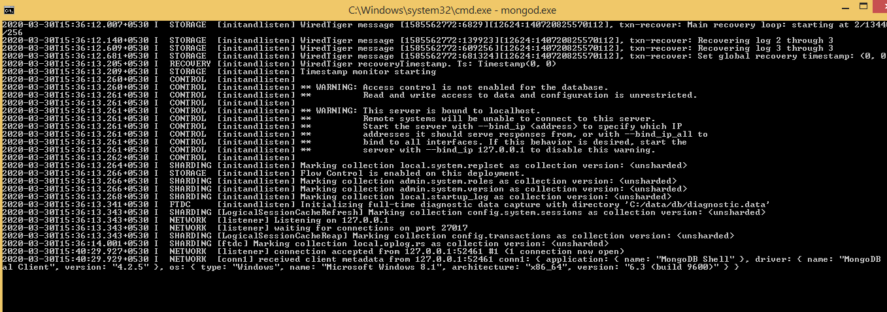
MongoDB Windows Service
Connection Accepted (Message)
1 Connection Now Open (Message)

Slide 23
Starting and Stopping MongoDB
To Start / Restart use command in Command Prompt
“ C:\mongodb\bin\mongo.exe”
To Stop just exit the Command Prompt

Slide 24
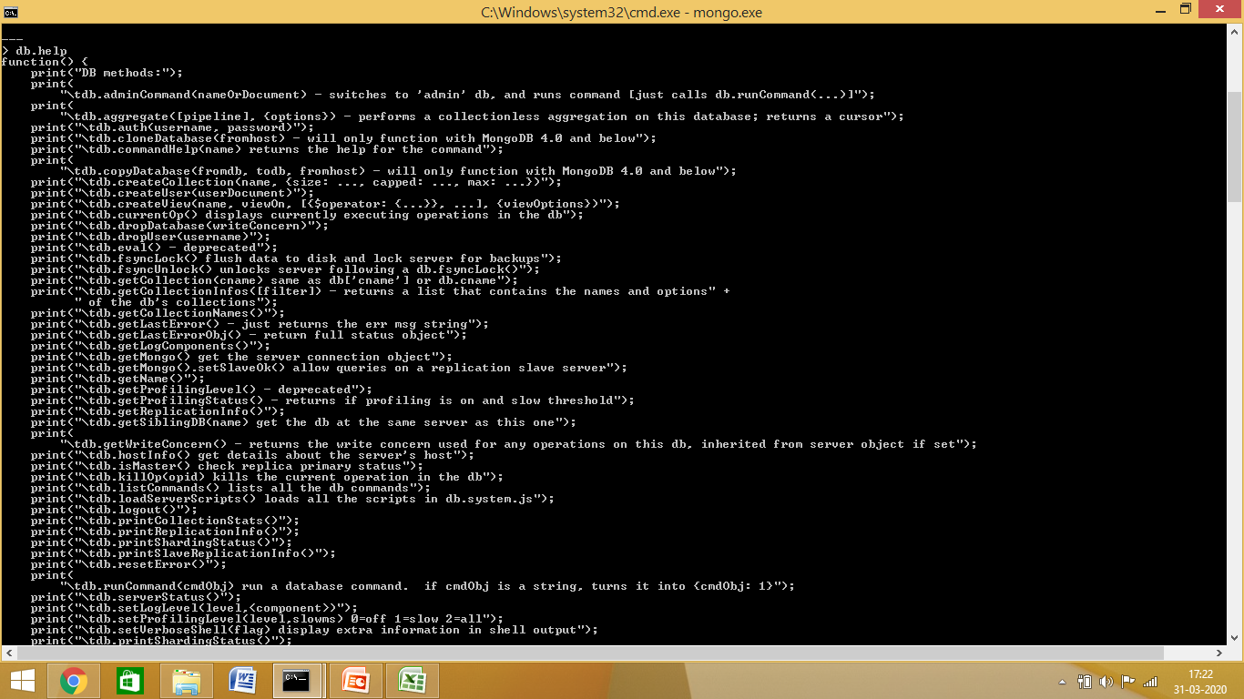
Getting help in MongoDB
With db.help() in Mongodb client we can get list of Commands.

Slide 25
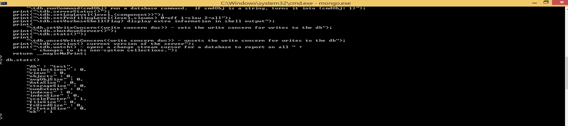
Obtaining MongoDB Statistics
Use the command db.stats() in MongoDB client to obtain the stats about MongoDB server.

Slide 26
Data Modelling in MongoDB
Creating Database
Dropping Database
Creating Collection
Dropping Collection

Slide 27
Creating Database in MongoDB
The “use” Command
The command will create a new database if it doesn't exist, otherwise it will return the existing database.
Syntax:-
Basic syntax of use DATABASE statement is as follows −
use DATABASE_NAME

Slide 28
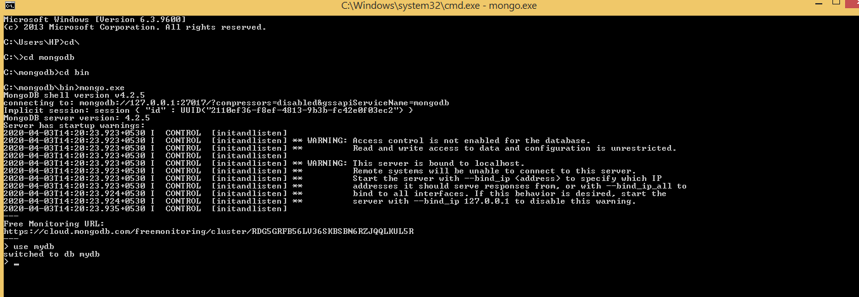
Creating Database in MongoDB
In command prompt

Slide 29
Using Database in MongoDB
If you want to use a database with name <mydb>, then use DATABASE statement would be as follows:
>use mydb
switched to db mydb

Slide 30
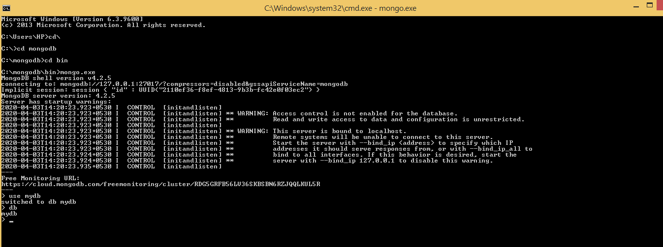
Using Database in MongoDB
To check your currently selected database, use the command db

Slide 31
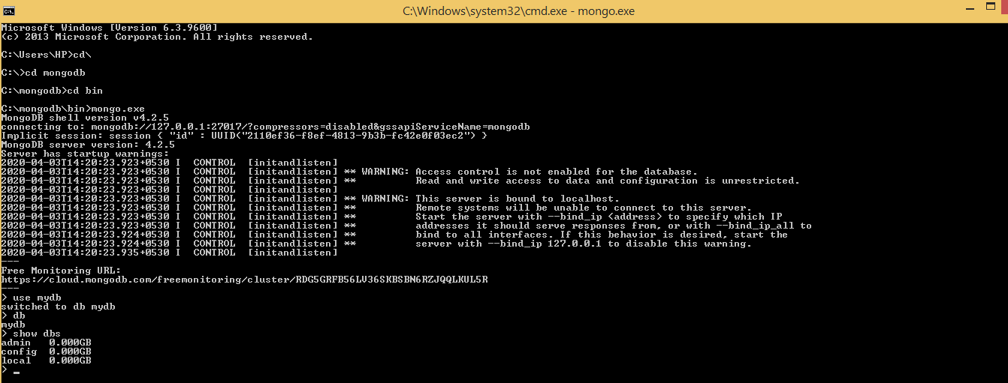
Database Listing in MongoDB
To check your databases list, use the command show dbs.

Slide 32
Dropping Database in MongoDB
Our created database (mydb) is not present in list. To display database, we need to insert at least one document into it.
The dropDatabase() Method
MongoDB db.dropDatabase() command is used to drop a existing database.

Slide 33
Dropping Database in MongoDB
Syntax:-
Basic syntax of dropDatabase() command is as follows −
db.dropDatabase()
This will delete the selected database.
mydb.dropDatabase() command will drop “mydb” database.

Slide 34
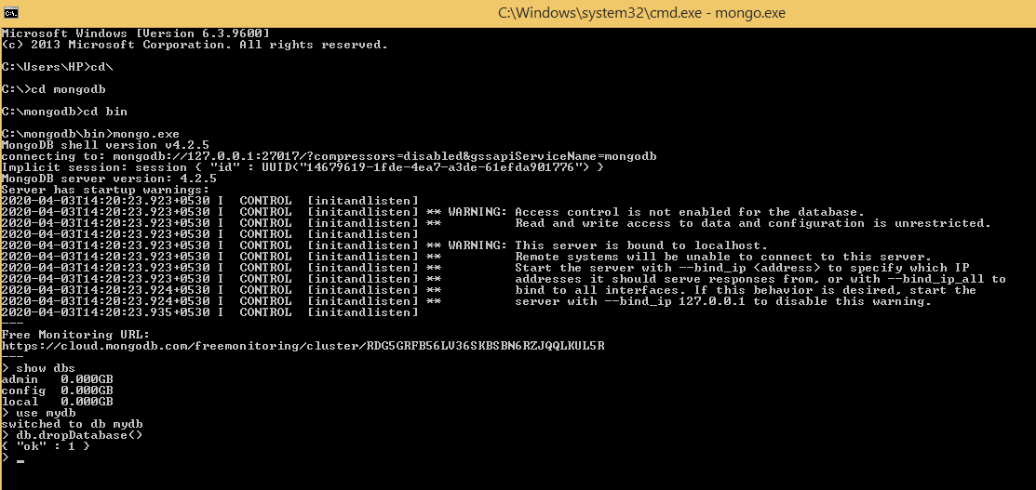
Dropping Database in MongoDB
Dropping “mydb” Database

Slide 35
Creating Collection
The createCollection() Method
In MongoDB db.createCollection(name, options) is used to create collection
Syntax
Basic syntax of createCollection() command is as follows −
db.createCollection(name, options)

Slide 36
Creating Collection
In the command, name is name of collection to be created. Options is a document and is used to specify configuration of collection.
Parameter | Type | Description
Name | String | Name of the collection to be created
Options | Document | (Optional) Specify options about memory size and indexing

Slide 37
Creating Collection
Options parameter is optional, so you need to specify only the name of the collection. Following is the list of options you can use −
Field | Type | Description
capped | Boolean | (Optional) If true, enables a capped collection. Capped collection is a fixed size collection that automatically overwrites its oldest entries when it reaches its maximum size. If you specify true, you need to specify size parameter also.
autoIndexId | Boolean | (Optional) If true, automatically create index on _id field.s Default value is false.
size | Number | (Optional) Specifies a maximum size in bytes for a capped collection. If capped is true, then you need to specify this field also.
max | Number | (Optional) Specifies the maximum number of documents allowed in the capped collection.

Slide 38
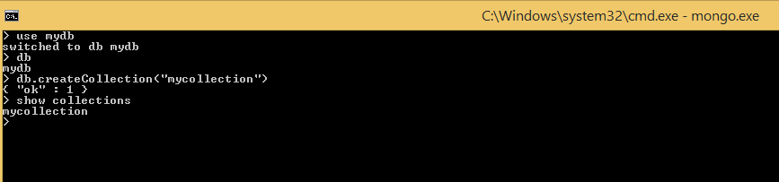
Creating Collection
Example : Create a collection with name “mycollection”
Check using command “show collections”

Slide 39
Dropping Collection
The drop() Method
In MongoDB's db.collection.drop() is used to drop a collection from the database.
Syntax
Basic syntax of drop() command is as follows −
db.COLLECTION_NAME.drop()

Slide 40
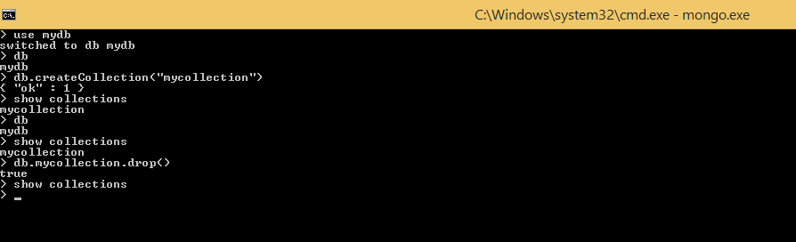
Dropping Collection
Output on Command Prompt

Slide 41
Data Types and Document Operations in MongoDB
Range of Data Types
Inserting Document
Querying Document
Updating Document
Deleting Document

Slide 42
Range of Data Types
MongoDB supports many data types. Few of them are :
String − This is the most commonly used data type to store the data. String in MongoDB must be UTF-8 valid.
Integer − This type is used to store a numerical value. Integer can be 32 bit or 64 bit depending upon your server.
Boolean − This type is used to store a boolean (true/ false) value.
Double − This type is used to store floating point values.

Slide 43
Range of Data Types
Min/ Max keys − This type is used to compare a value against the lowest and highest BSON elements.
Arrays − This type is used to store arrays or list or multiple values into one key.
Timestamp − ctimestamp. This can be handy for recording when a document has been modified or added.
Object − This datatype is used for embedded documents.

Slide 44
Range of Data Types
Null − This type is used to store a Null value.
Symbol − This data type is used identically to a string; however, it's generally reserved for languages that use a specific symbol type.
Date − This data type is used to store the current date or time in UNIX time format. You can specify your own date time by creating object of Date and passing day, month, year into it.
Object ID − This data type is used to store the document’s ID.

Slide 45
Range of Data Types
Binary data − This data type is used to store binary data.
Code − This data type is used to store JavaScript code into the document.
Regular expression − This data type is used to store regular expression.

Slide 46
Inserting Document
To insert data into MongoDB collection, you need to use MongoDB's insert() method.
Syntax
The basic syntax of insert() command is as follows −
>db.COLLECTION_NAME.insert(document)

Slide 47
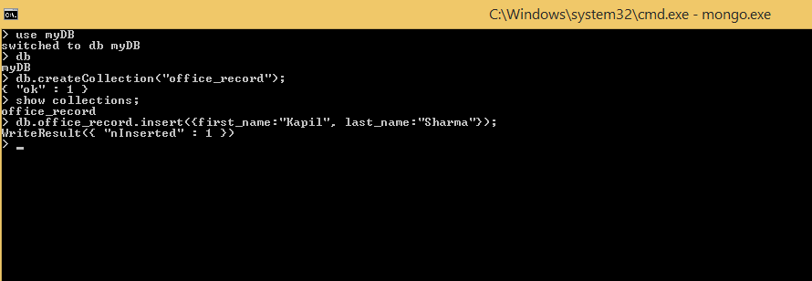
Inserting Document
Inserting document having two fields:

Slide 48
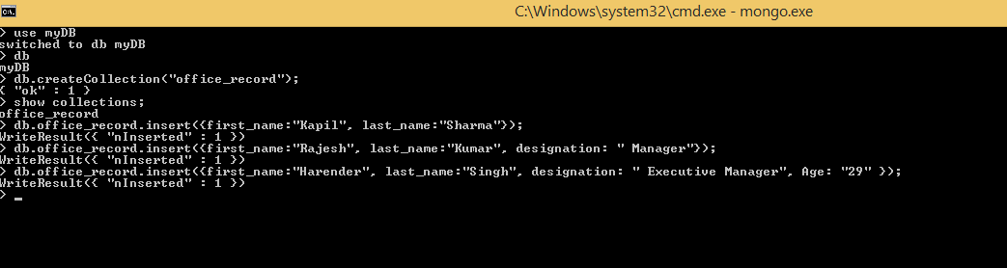
Inserting Document
Inserting next document with more number of fields.
MongoDB being NoSQL doesn’t have fixed table format as in RDBMS.

Slide 49
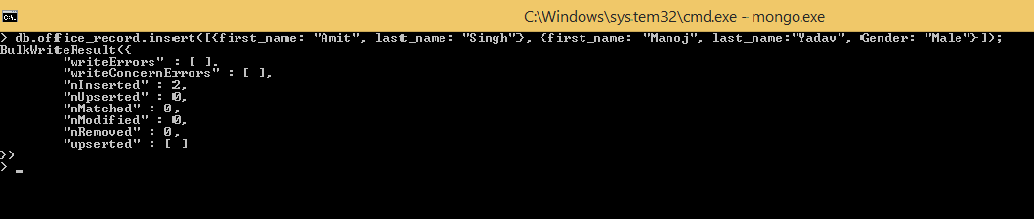
Inserting Document
Inserting array of documents:

Slide 50
Querying Document
To query data from MongoDB collection, you need to use MongoDB's find() method.
find() method will display all the documents in a non-structured way.
Syntax
The basic syntax of find() method is as follows −
>db.COLLECTION_NAME.find()

Slide 51
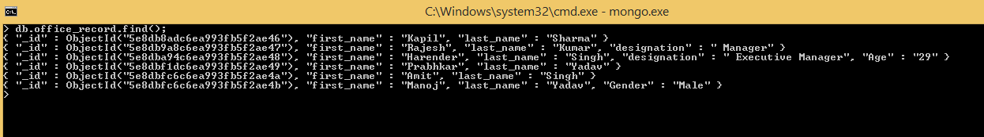
Querying Document
db.office_record.find() used to see the existed documents in the collection “office_record”.

Slide 52
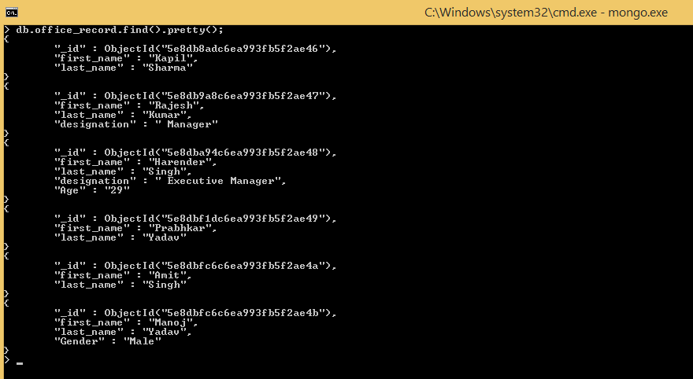
Querying Document
To display the results in a formatted way, you can use pretty() method.
Syntax
>db.COLLECTION_NAME.find().pretty()

Slide 53
Updating Document
MongoDB's update() and save() methods are used to update document into a collection.
The update() method updates the values in the existing document.
The save() method replaces the existing document with the document passed in save() method.

Slide 54
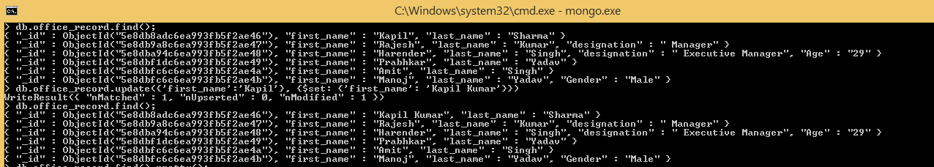
Updating Document
Syntax
The basic syntax of update() method is as follows −
>db.COLLECTION_NAME.update(SELECTION_CRITERIA, UPDATED_DATA)

Slide 55
Updating Document
MongoDB updateMany() method
The updateMany() method updates all the documents that matches the given filter.
Syntax:
The basic syntax of updateMany() method is as follows:
>db.COLLECTION_NAME.update(<filter>, <update>)

Slide 56
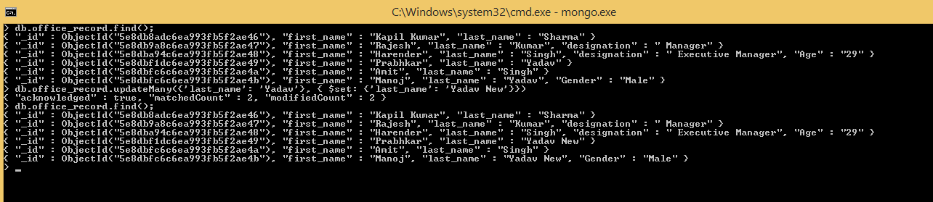
Updating Document
Implementation of updatemany() method

Slide 57
Updating Document
MongoDB Save() Method
The save() method replaces the existing document with the new document passed in the save() method.
Syntax
The basic syntax of MongoDB save() method is shown below −
>db.COLLECTION_NAME.save({_id:ObjectId(),NEW_DATA})

Slide 58
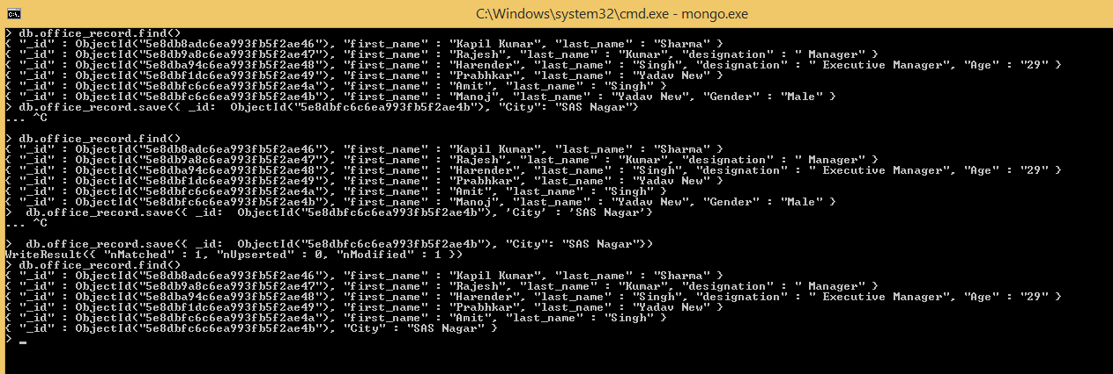
Updating Document
Implementation of save() method

Slide 59
Deleting a Document
The remove() Method
MongoDB's remove() method is used to remove a document from the collection. remove() method accepts two parameters. One is deletion criteria and second is justOne flag.
deletion criteria − (Optional) deletion criteria according to documents will be removed.
justOne − (Optional) if set to true or 1, then remove only one document.

Slide 60
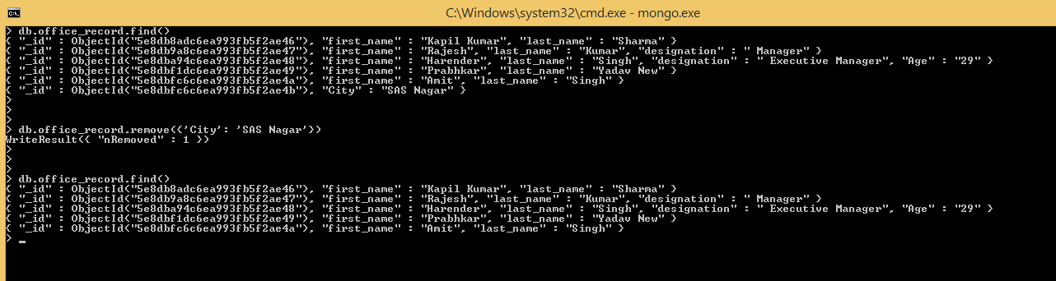
Deleting a Document
Syntax
Basic syntax of remove() method is as follows −
>db.COLLECTION_NAME.remove(DELLETION_CRITTERIA)

Slide 61
Deleting a Document
Remove Only One
If there are multiple records and you want to delete only the first record, then set justOne parameter in remove() method.
>db.COLLECTION_NAME.remove(DELETION_CRITERIA,1)

Slide 62
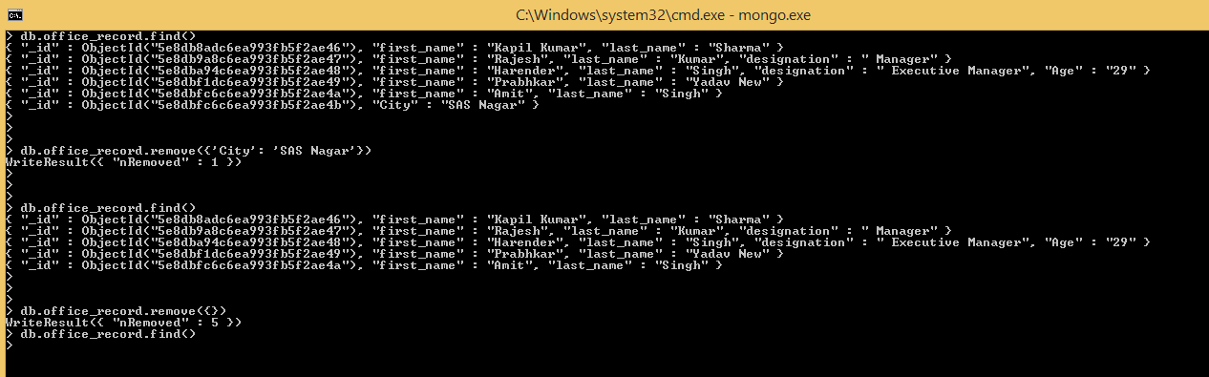
Deleting a Document
Remove All Documents
If you don't specify deletion criteria, then MongoDB will delete whole documents from the collection. This is equivalent of SQL's truncate command.

Slide 63
Projections in MongoDB
In MongoDB, projection means selecting only the necessary data rather than selecting whole of the data of a document. If a document has 5 fields and you need to show only 3, then select only 3 fields from them.
Finding Documents
Limiting Documents
Shorting Documents

Slide 64
Finding Documents
The find() Method
MongoDB's find() method, explained in MongoDB Query Document accepts second optional parameter that is list of fields that you want to retrieve.
In MongoDB, when you execute find() method, then it displays all fields of a document.
To limit this, you need to set a list of fields with value 1 or 0. 1 is used to show the field while 0 is used to hide the fields.

Slide 65
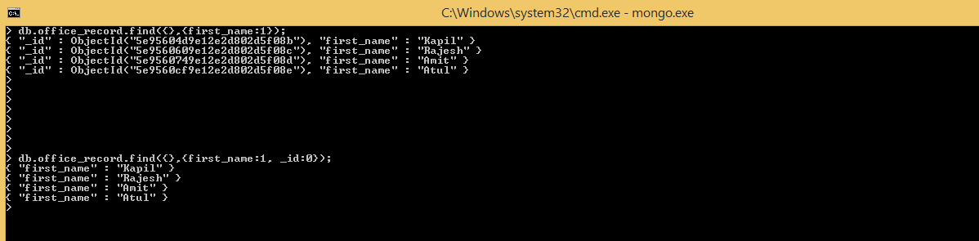
Finding Documents
Syntax
The basic syntax of find() method with projection is as follows −
>db.COLLECTION_NAME.find({},{KEY:1})

Slide 66
Limiting Documents
The Limit() Method
To limit the records in MongoDB, you need to use limit() method.
The method accepts one number type argument, which is the number of documents that you want to be displayed.

Slide 67
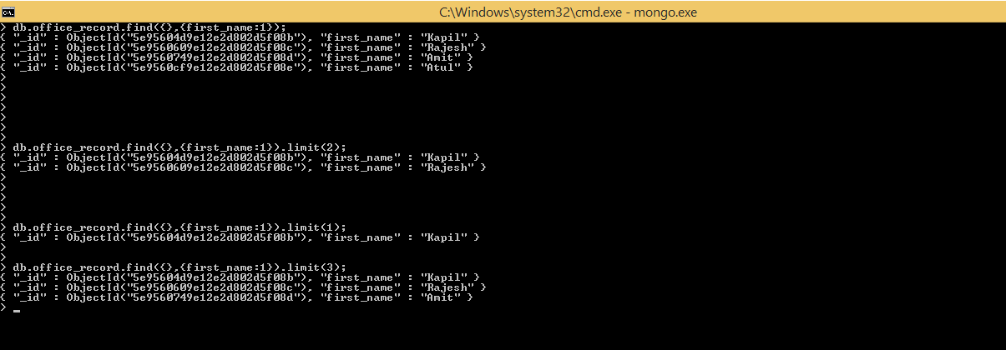
Limiting Documents
Syntax
The basic syntax of limit() method is as follows −
>db.COLLECTION_NAME.find().limit(NUMBER)

Slide 68
Limiting Documents
MongoDB Skip() Method
Apart from limit() method, there is one more method skip() which also accepts number type argument and is used to skip the number of documents.

Slide 69
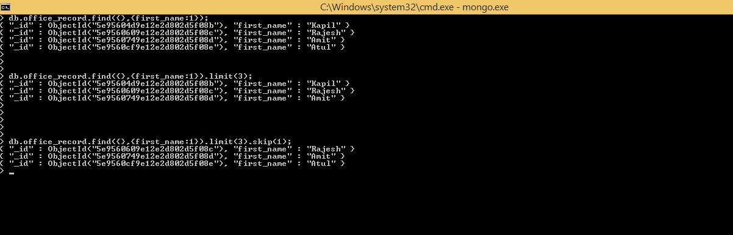
Limiting Documents
Syntax
The basic syntax of skip() method is as follows −
>db.COLLECTION_NAME.find().limit(NUMBER).skip(NUMBER)
Default value in skip() is Zer0 (0)

Slide 70
Sorting Documents
The sort() Method
To sort documents in MongoDB, you need to use sort() method. The method accepts a document containing a list of fields along with their sorting order.
To specify sorting order 1 and -1 are used. 1 is used for ascending order while -1 is used for descending order.

Slide 71
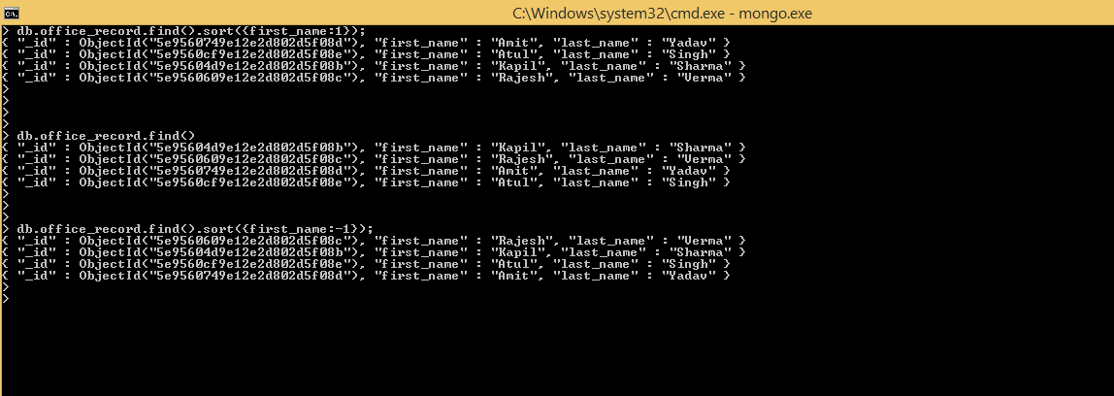
Sorting Documents
Syntax
The basic syntax of sort() method is as follows −
>db.COLLECTION_NAME.find().sort({KEY:1})

Slide 72
Indexing
Indexes support the efficient resolution of queries. Without indexes, MongoDB must scan every document of a collection to select those documents that match the query statement.
Such scan is highly inefficient and require MongoDB to process a large volume of data.
Indexes are special data structures, that store a small portion of the data set in an easy-to-traverse form.
The index stores the value of a specific field or set of fields, ordered by the value of the field as specified in the index.

Slide 73
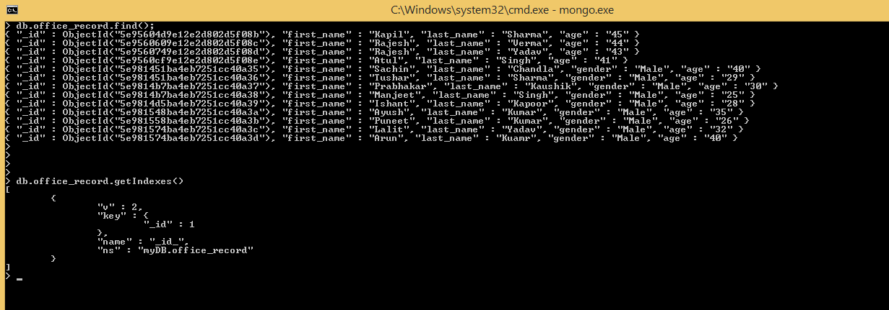
Default Index
Before creating new Index let us check existing Indexes.
For obtaining information about existing Indexes use method getIndexes()
_id is the default index

Slide 74
Creating Indexes
The createIndex() Method
To create an index, you need to use createIndex() method of MongoDB.
Syntax:
The basic syntax of createIndex() method is as follows().
>db.COLLECTION_NAME.createIndex({KEY:1})
Here key is the name of the field on which you want to create index and 1 is for ascending order. To create index in descending order you need to use -1.

Slide 75
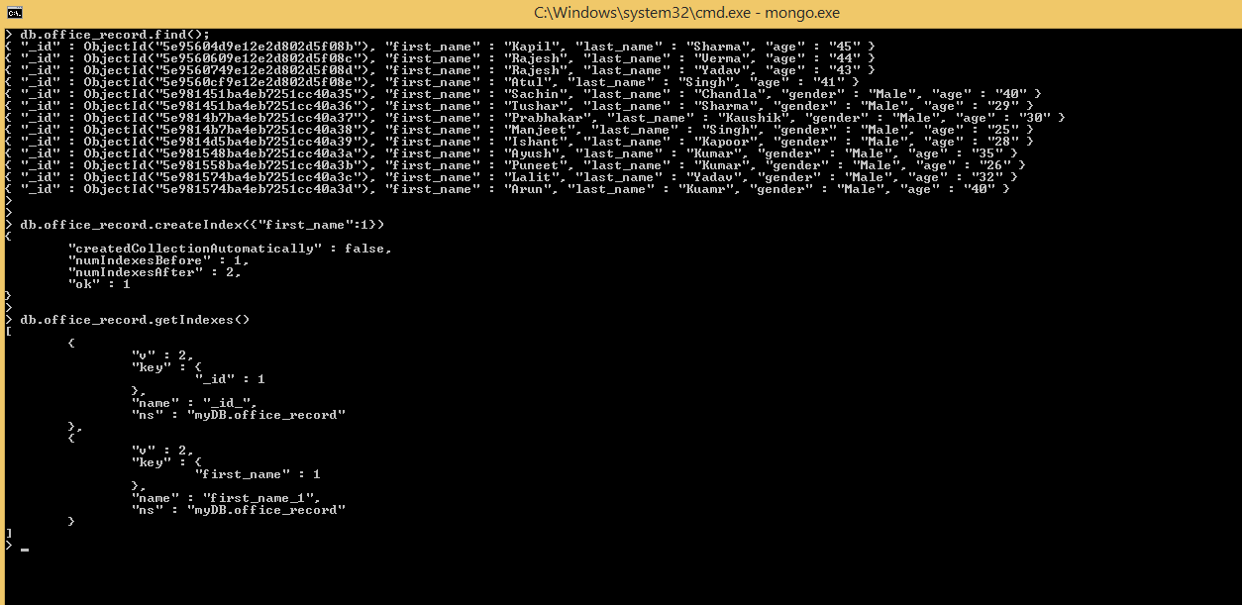
Creating and Getting Indexes
Implementation of createIndex() and getIndexes() method.

Slide 76
Dropping Index
The dropIndex() method
You can drop a particular index using the dropIndex() method of MongoDB.
Syntax:
The basic syntax of DropIndex() method is as follows().
>db.COLLECTION_NAME.dropIndex({KEY:1})

Slide 77
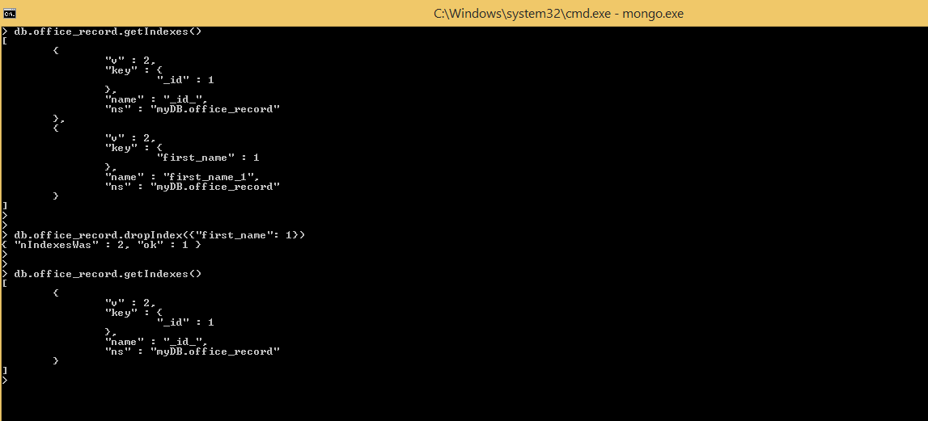
Dropping Indexes
Implementation of dropIndex() method

Slide 78
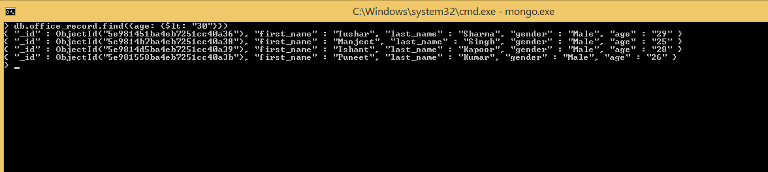
Effect of Indexes
First, use method find() to get documents with age less than 30.
Now examine the effort done for searching these 4 documents

Slide 79
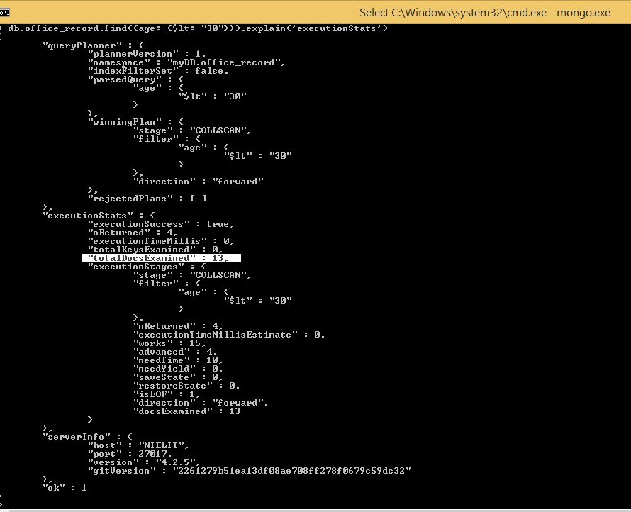
Effect of Indexes
Implementing method explain(‘executionStats’)
Result shows that 13 records were examined for searching documents with age less than 30.

Slide 80
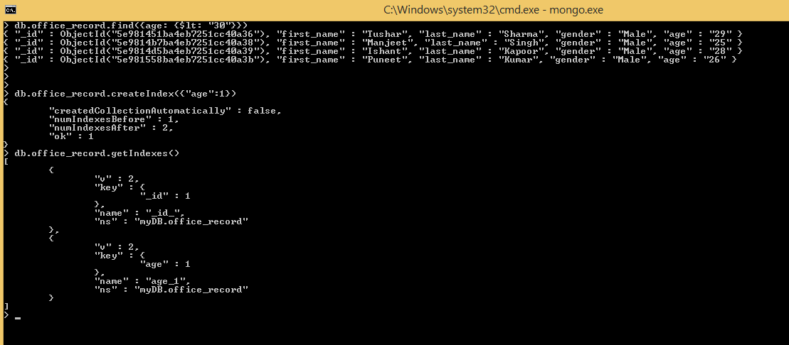
Effect of Indexes
Now set “age” as an Index.

Slide 81
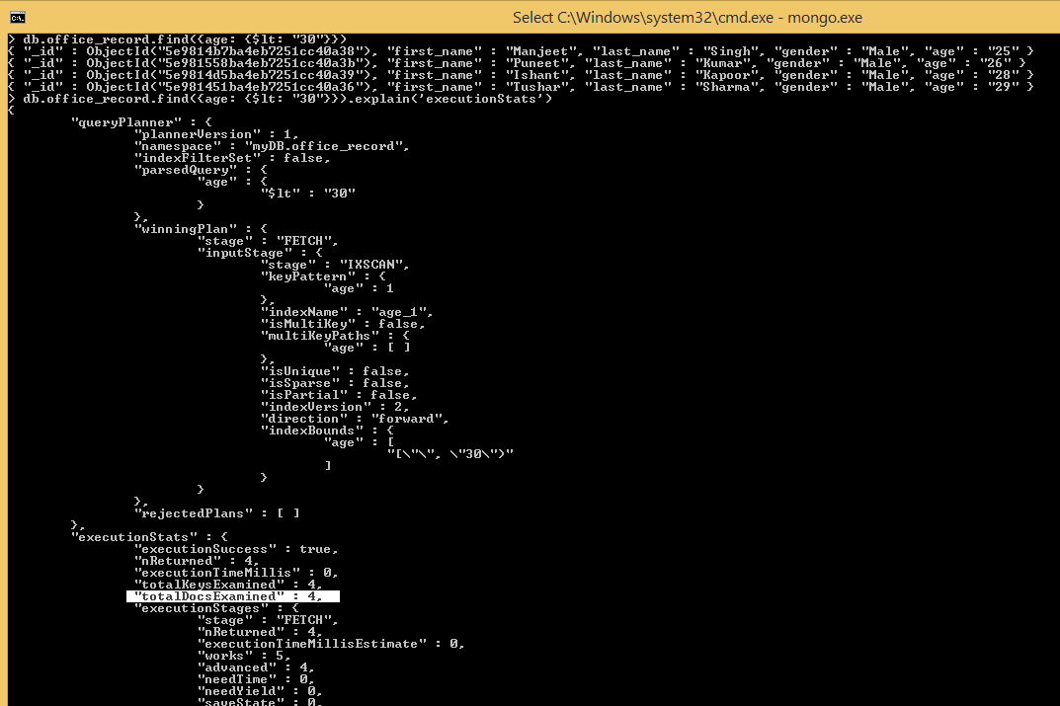
Effects of Indexes
See the effect on 4 document need to be examined.

Slide 82
Aggregation in MongoDB
Aggregations operations process data records and return computed results.
Aggregation operations group values from multiple documents together, and can perform a variety of operations on the grouped data to return a single result.
In SQL count(*) and with group by is an equivalent of MongoDB aggregation.
The aggregate() Method
For the aggregation in MongoDB, you should use aggregate() method.

Slide 83
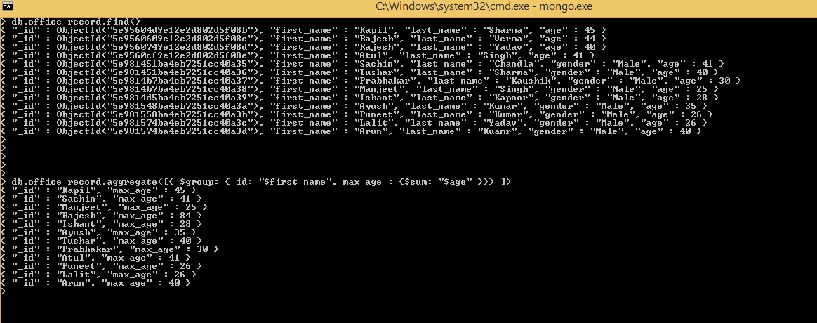
Aggregation in MongoDB
Syntax
Basic syntax of aggregate() method is as follows −
>db.COLLECTION_NAME.aggregate(AGGREGATE_OPERATION)

